Slide 1
Foundations of Cryptography improved attack of shift cipher, Vigenère cipher, Kasiski’s method, index of coincidence method
LiangFeng Zhang
zhanglf@shanghaitech.edu.cn

Slide 2
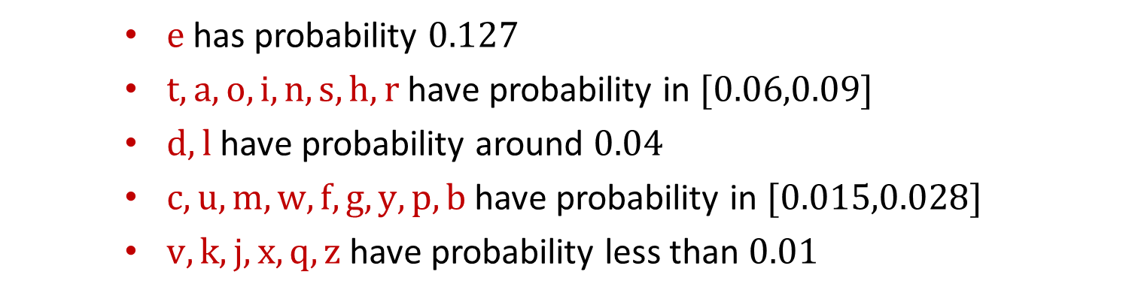
Letter Frequencies (English)
$e$ has probability $0.127$
$t,a,o,i,n,s,h,r$ have probability in $[0.06,0.09]$
$d,l$ have probability around $0.04$
$c,u,m,w,f,g,y,p,b$ have probability in $[0.015,0.028]$
$v,k,j,x,q,z$ have probability less than $0.01$

Slide 3
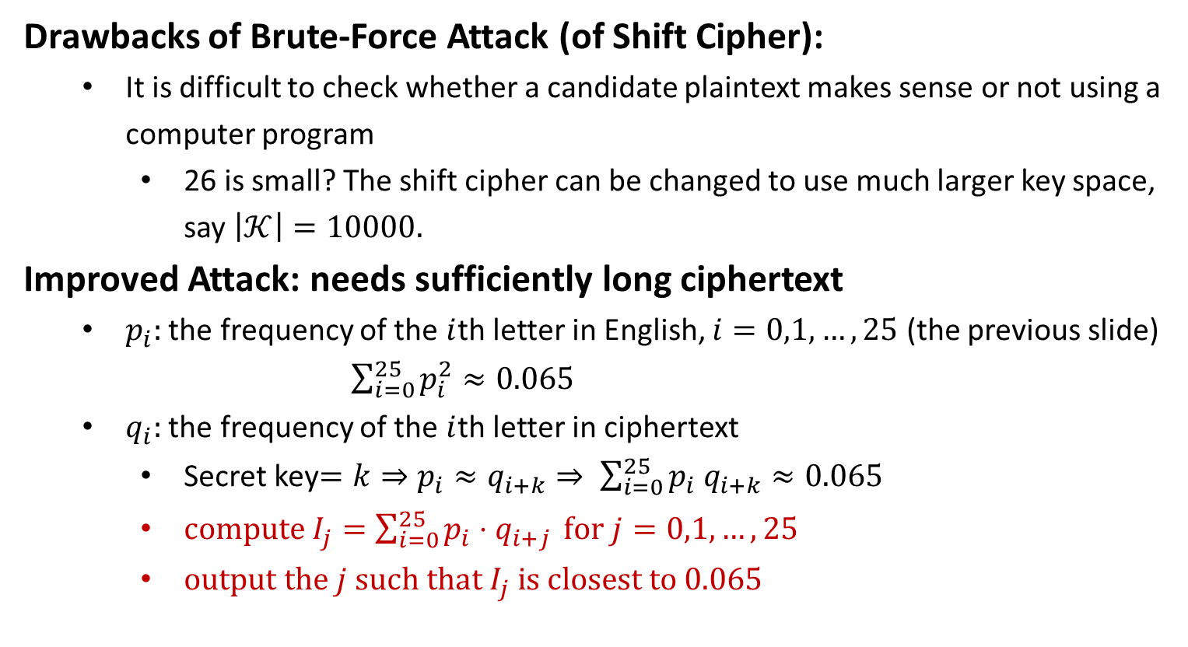
Improved Attack of Shift Cipher
Drawbacks of Brute-Force Attack (of Shift Cipher):
It is difficult to check whether a candidate plaintext makes sense or not using a computer program
26 is small? The shift cipher can be changed to use much larger key space, say $\left|𝒦\right|=10000.$
Improved Attack: needs sufficiently long ciphertext
$p_{i}:$ the frequency of the $i$th letter in English, $i=0,1,…,25$ (the previous slide)
$\sum_{i=0}^{25}{p_{i}^{2}}≈0.065$
$q_{i}:$ the frequency of the $i$th letter in ciphertext
Secret key$=k⇒p_{i}≈q_{i+k}⇒ \sum_{i=0}^{25}{p_{i} q_{i+k}≈0.065}$
$compute I_{j}=\sum_{i=0}^{25}{p_{i}⋅q_{i+j}} for j=0,1,…,25$
$output the j such that I_{j} is closest to 0.065$

Slide 5
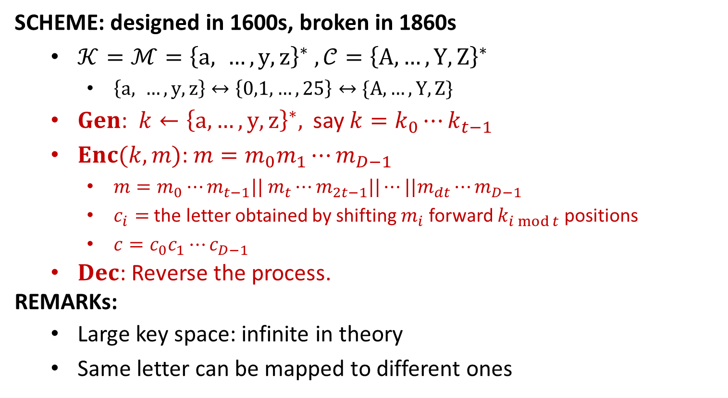
Vigenère Cipher
SCHEME: designed in 1600s, broken in 1860s
$𝒦=ℳ={\left\{a, …, y, z\right\}}^{∗} , 𝒞={\left\{A,…,Y,Z\right\}}^{∗}$
$\left\{a, …, y, z\right\}↔\left\{0,1,…,25\right\}↔\{A,…,Y,Z\}$
$Gen$: $k←{\left\{a,…,y,z\right\}}^{∗},$ say $k=k_{0}⋯k_{t−1}$
$Enc(k,m)$: $m=m_{0}m_{1}⋯m_{D−1}$
$m=m_{0}⋯m_{t−1}|| m_{t}⋯m_{2t−1}||⋯||m_{dt}⋯m_{D−1}$
$c_{i}=$ the letter obtained by shifting $m_{i}$ forward $k_{i mod t}$ positions
$c=c_{0}c_{1}⋯c_{D−1}$
$Dec$: Reverse the process.
REMARKs:
Large key space: infinite in theory
Same letter can be mapped to different ones

Slide 6
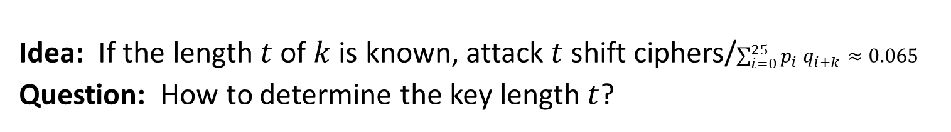
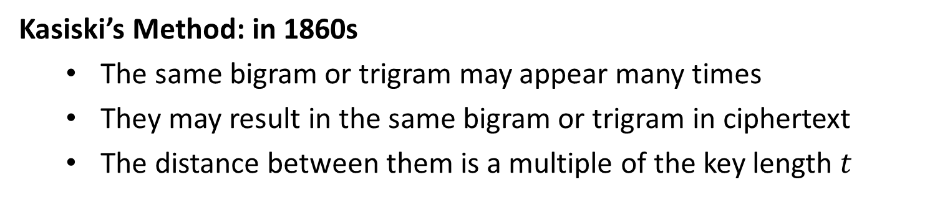
Attacks
Idea: If the length $t$ of $k$ is known, attack $t$ shift ciphers/$\sum_{i=0}^{25}{p_{i} q_{i+k}≈0.065}$
Question: How to determine the key length $t$?
Kasiski’s Method: in 1860s
The same bigram or trigram may appear many times
They may result in the same bigram or trigram in ciphertext
The distance between them is a multiple of the key length $t$

Slide 7
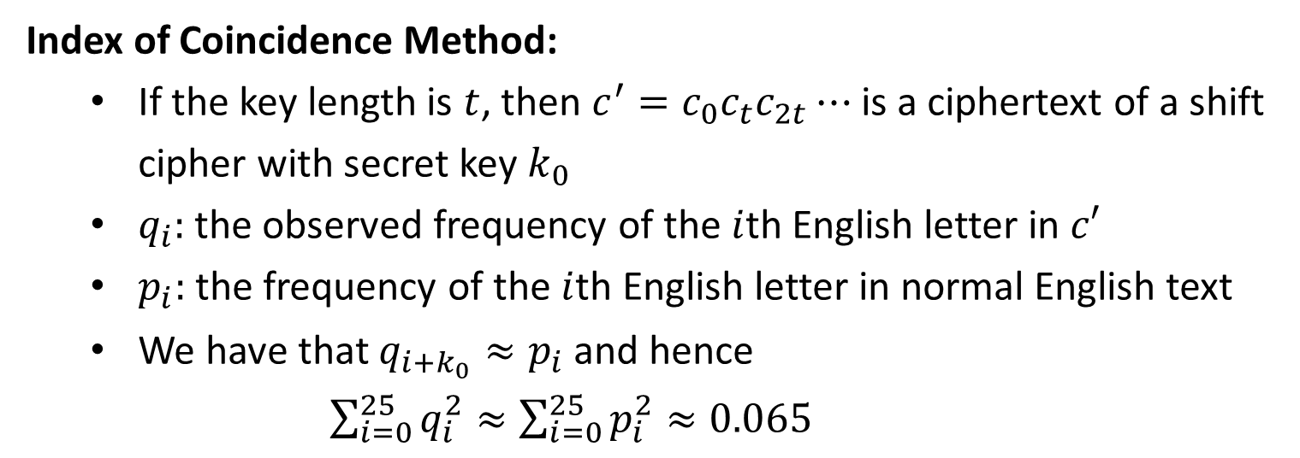
Attacks
Index of Coincidence Method:
If the key length is $t$, then $c^{′}=c_{0}c_{t}c_{2t}⋯$ is a ciphertext of a shift cipher with secret key $k_{0}$
$q_{i}:$ the observed frequency of the $i$th English letter in $c′$
$p_{i}:$ the frequency of the $i$th English letter in normal English text
We have that $q_{i+k_{0}}≈p_{i}$ and hence
$\sum_{i=0}^{25}{q_{i}^{2}}≈\sum_{i=0}^{25}{p_{i}^{2}≈0.065}$

Slide 8
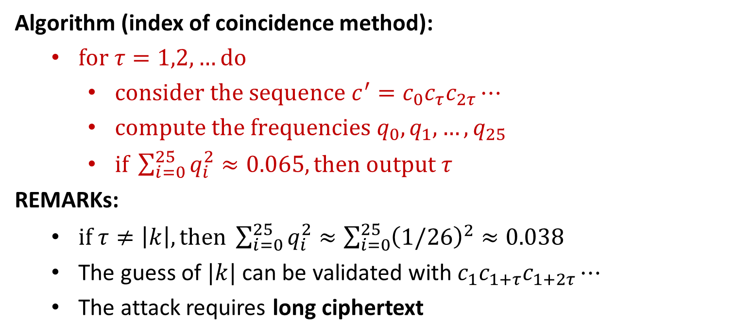
Attacks
Algorithm (index of coincidence method):
$for τ=1,2,…do$
$consider the sequence c^{′}=c_{0}c_{τ}c_{2τ}⋯$
$compute the frequencies q_{0},q_{1},…,q_{25}$
$if \sum_{i=0}^{25}{q_{i}^{2}}≈0.065, then output τ$
REMARKs:
$if τ≠\left|k\right|, then \sum_{i=0}^{25}{q_{i}^{2}}≈\sum_{i=0}^{25}{{\left(1/26\right)}^{2}}≈0.038$
The guess of $|k|$ can be validated with $c_{1}c_{1+τ}c_{1+2τ}⋯$
The attack requires long ciphertext

Slide 10
Lessons and Modern Approach
All historical ciphers are badly broken
ciphertext-only attack (COA): the adversary learns one ciphertext
Recover the secret key and the message
Classical cryptography is an art
Designing a secure cipher is difficult
Historical ciphers have no security proof
Modern cryptography is a science (Principles of Modern Cryptography)
Formal Definitions (of Security)
Precise Assumptions
Proofs of Security

